Slide 1
Population Growth vs Breweries
The Banananimals: Amanda Gaston, Scott Wittie, Nathan Cruz, and Ebony Martin

Slide 2
Overview
Does population growth contribute to the increased number of breweries across the US?
Does income growth contribute to the increased number of breweries across the US?
Questions asked:
Population growth overtime
Avg Income
Breweries per region
Population size vs number of breweries
Notes:
Bullet 1: Our hypothesis is ‘Does increased population growth contribute to the increased number of breweries across the US?’
Sub Bullet 1: We chose to look at whether or not population growth affects brewery growth because in the Charlotte area, we always see new breweries popping up and we hear about new breweries opening up in nearby cities such as Ashville so we thought it would be fun to see if there was any correlation between population growth and the number of breweries opening.
Bullet 2: We asked several questions around population growth, average income, breweries per region, and population size vs number of breweries to help draw any correlations between population size and the number of breweries. We broke down population size into standard regions, such as northeast, midwest, south, and west, as a way to better digest and analyze any correlations between population size and number of breweries.

Slide 3
Questions and Data
Has the US population increased overtime?
Year
Avg population size
Does income affect the number of breweries across the US?
Avg income
# of breweries
Does population size affect the number of breweries across the US?
Population size
# of breweries
What is the number of breweries per region (northeast, midwest, south, west) in the US?
Regions
# of breweries
Which region has the greatest population in the US?
Region
Population size brackets
Notes:
To locate the data we needed to answer each of these questions, we obtained census data from census.gov and BreweryDB. Census.gov contains a complete record of census data for each city in the US and BreweryDB is an API that contains a list of breweries in each city across the US. Once we cleaned the data from both sources, we then massaged the data by grouping columns and using counters.

Slide 4
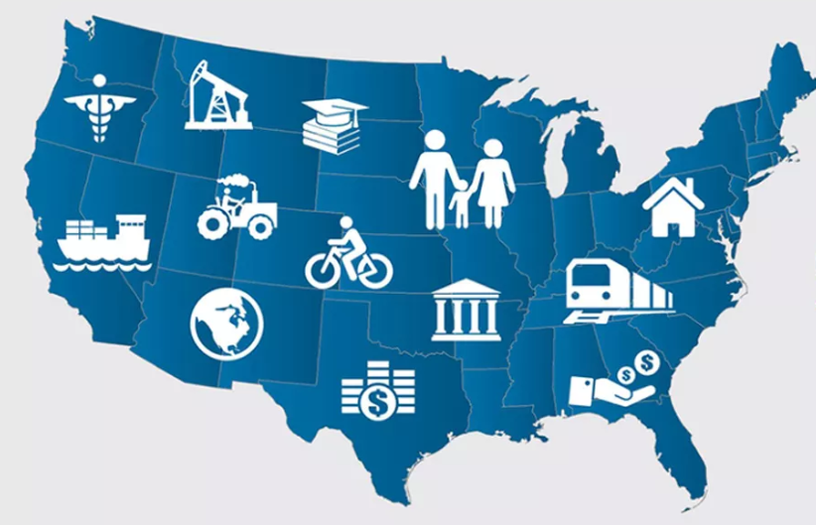
Census & Income Data Cleanup
Dropped columns
Renamed columns
State vs abbreviation
Limit to specific 7 year range
Merge, merge, merge
Notes:
Bullet 1: To begin cleaning the census data, we dropped useless columns such as the county, state code, and place code. We basically dropped all columns that were not the state, city, year, and population
Bullet 2: We renamed the columns for better clarity. For example we renamed the Census2010Pop column to 2010 and the Median Income column to Median 2010
Bullet 3: We changed the data around state name to being the full state name instead of the abbreviation of the state
Bullet 4: We chose to focus on census data per city for the years 2010 to 2017. The 7 year span allowed us to see trends in population growth.
Bullet 5: We merged the census and income data to create a full picture of how the population growth affected the average income levels per city.

Slide 5

BreweryDB API Data Cleanup
Filter by estab year, city, state
Remove null values
Dropped any breweries established before 2010
Remove all breweries not within the US
Notes:
Bullet 1: For the API requests, we our query parameters focused on the year the brewery was opened, the city the brewery is located in, the state, and whether or not the brewery is still open for business
Bullet 2: There were a lot of entries in the API that produced null values in one or more columns. We removed those entries to make it easier to compare the number of breweries to the population and average income of the city and state
Bullet 3: We dropped any breweries that were established before 2010 to match our census data which is from 2010-2017.
Bullet 4: We removed all breweries that were outside of the US to match our census data.

Slide 6

Data Analysis
Merged yearly population with average income
Merged yearly population, avg income, brewery, city, state, estab. year, and still open
For loop
Split queries
Notes:
Bullet 1: We saved the census and income data in separate CSV files. We then wrote a script to merge the files to create a single clean file that contained the population, year, and median income level.
Bullet 2: We merged the population, income, brewery, city, and state data into a CSV file in order to determine what comparisons and high level conclusions we came such as whether or not a decrease in population or income was a factor in a brewery closure.
Bullet 3: The BreweryDB API has about 261 pages of data about breweries from around the world. We used a for loop to loop through each page and pull all the breweries across the US. Some indexes had null values. To work with the null values, we added a try- except loop to collect indexes that contain null values without completely stopping the for loop.
Bullet 4: We had to split the API queries that we created because of the number of pages the calls needed to loop through to get all the needed information for analysis.

Slide 7
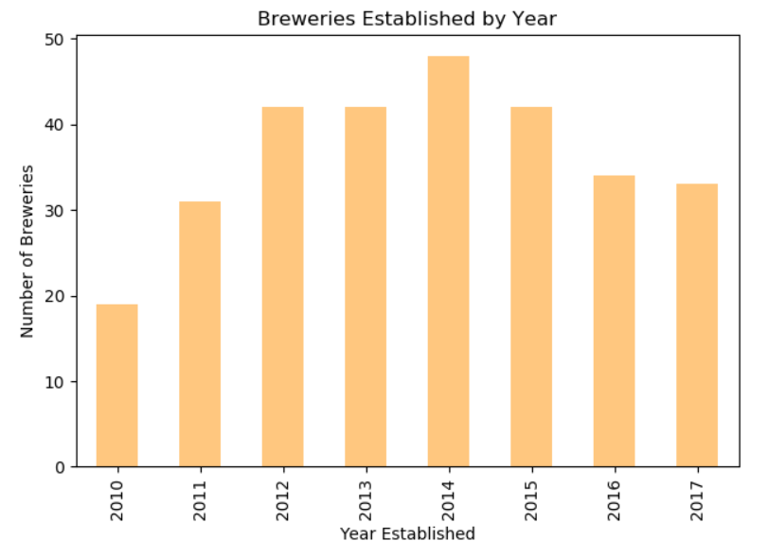

Slide 8
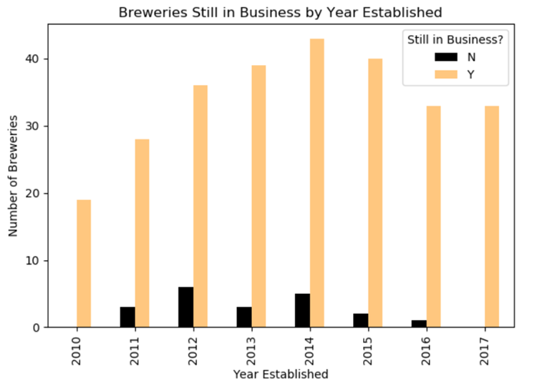

Slide 9
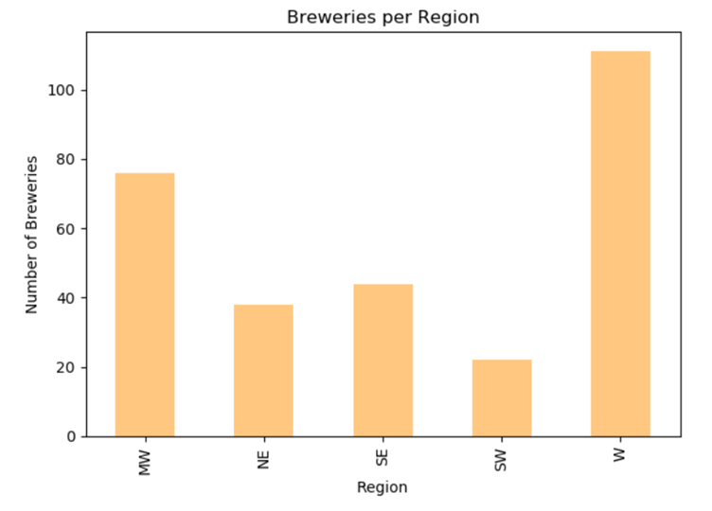

Slide 10

Conclusion
Does population growth contribute to the increased number of breweries across the US?
Does income growth contribute to the increased number of breweries across the US?
Notes:
If you remember our hypothesis which is ‘Does population growth contribute to the increased number of breweries across the US?’. Based on our analysis, we have determined…..

Slide 11

Conclusion
No, there is not a strong correlation between population growth and brewery growth.
No, there is not a strong correlation between income growth and brewery growth.
Income growth and population growth together are somewhat linked to the growing number of breweries

Slide 12
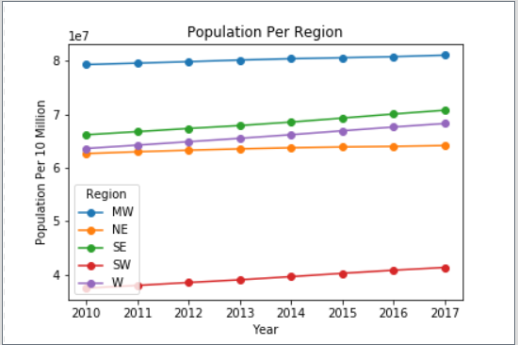

Slide 13
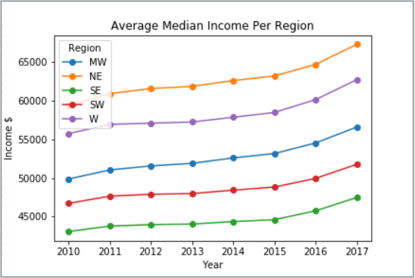

Slide 14
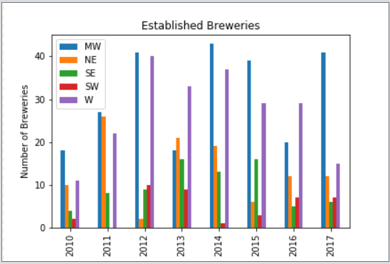

Slide 15
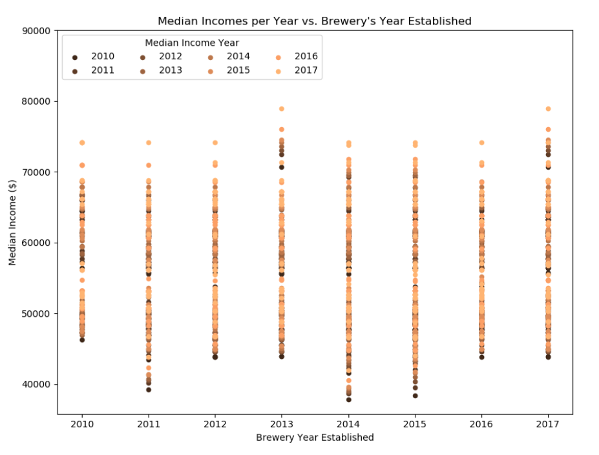

Slide 16
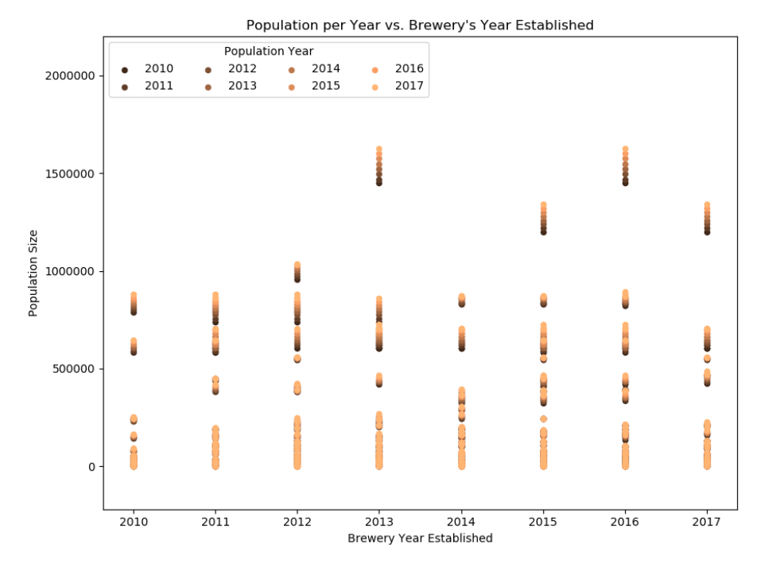

Slide 17
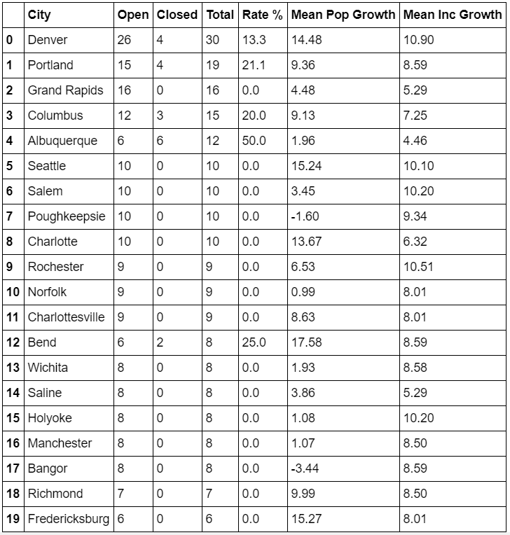

Slide 18

Challenges
Finding a good brewery API
Finding census and income data
How to break up and merge the census data and brewery data
Running out of memory
Knowing how and where to join dataframes
API call limit
Ensuring we had enough data
Notes:
Bullet 1: We struggled with finding an API that contained data about actual breweries instead of places such as restaurants and hotels that served beer.
Bullet 2: With the government shutdown we struggled to find available census data that spanned over a set number of years that also included the average income and population by city
Bullet 3:
Bullet 4 & 5: We continually ran into memory issues when trying to merge the census data due to the merge producing duplicate values. After about 3 days we realized the memory issues were being caused by incorrectly executing an outer join instead of a left join. Once we executed the left join and dropped all possible duplicates, the error messages about the memory disappeared.
Bullet 6: The paid BreweryDB API has an API call limit of 200 requests per day and 100 requests per minute. We solved the requests per minute by adding a sleep line as the API looped through the pages. We worked with the 200 requests per day limitation by having multiple team members buy the API.
Bullet 7: After pulling and cleaning all the brewery data, we only had about 550 records.

Slide 19

Other Factors
Age demographics of a city
Age demographics of brewery customers
Metro cities vs rural cities
Spike in new breweries in 2014
Rates of closure
Market saturation
Larger census sample
Correlation between marijuana legalization and breweries
Possible reasons as to why breweries closed

Slide 20


